Slide 1
Adobe Adoption & Enablement Strategy
March 5, 2025

Slide 2
Where We Stand — And Where We Go Next
What Has Been Accomplished
Migration to AEM as a Cloud Service (AEMaaCS)
hardrock.com and reverb.hardrock.com are live, Careers site launching March 23
Established Sites & Assets capabilities, scalable application framework, and cloud-native infrastructure.
Achieved operational go-live stability
What This Means
Phase 1 was about platform activation — establishing a scalable, future-forward foundation.
The core architecture is in place.
Now we transition from: Activation → Stabilization to Stabilization → Optimization
What Comes Next
Refinement of authoring experience and component maturity
Governance alignment and backlog prioritization
Expansion of AEM capabilities, scalable feature innovation
Integration across Adobe Experience Cloud

Slide 3
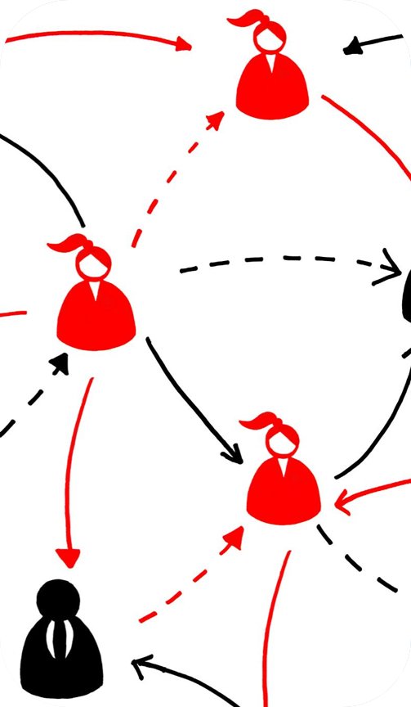
Scope and Objectives
Over the next 4 1hr sessions we will:
Outline communication strategies for teams adopting and using AEM
Share strategies for creating successful enablement hubs
Outcomes:
SHRSS will understand how to design, structure, and govern an enablement hub that supports ongoing Adobe AEM adoption
SHRSS will leave with frameworks and templates that can be reused for future rollouts, enhancements, or new teams

Slide 4
Communication Strategy Definition​
Defining clear communication strategies ensures stakeholders are informed and engaged throughout adoption.

Slide 5






An approach to adoption & enablement
CREATE
CREATE
DEPLOY
DEPLOY
SCALE
INITIATE
SCALE
INITIATE
DISCOVER
DISCOVER
Project Phases
Define Goals
Design Strategy
Prepare Organization
Support Organization
Adopt and Sustain
Adoption Success Areas
Vision Definition & Tracking
Leadership Alignment
Stakeholder Engagement
Communication
Learning & Enablement
Digital Experience & Capabilities
KNOWLEDGE
“I can explain why the change is needed, what it means for me and my team, and how our team/organization will benefit from the implementation of Adobe technology.”
”I have attended training and understand what resources are available to support me through the transition period of working with Adobe solutions.”
AWARENESS
ABILITY
“I am confident in my ability to use the Adobe Digital Experience platform and being data driven in my daily work.”
“I know the basics of the Adobe Digital Experience initiative and why it is being executed.”
DESIRE
REINFORCEMENT
“I can articulate how I need to change and am becoming supportive and willing to accept the changes coming ahead.”
“I know that leadership has listened to my concerns/feedback and is addressing them proactively, so me and my team are sufficiently prepared.”
“My team has weekly discussions on how we can continue to improve our processes to maximize the capabilities provided by the Adobe Digital Experience platform.”
“I regularly report on and communicate the value/progress of Adobe to leadership.”

Slide 6




A communication strategy
AWARENESS
DESIRE
KNOWLEDGE
ABILITY
REINFORCEMENT
Storyline | Case for Adobe Technology | Detailed Change Messaging | Prepare for Go-Live | Focus on the Future | Sustain the Change
Purpose | Explain the ‘why’ | Set expectations | Manage uncertainty and provide practical training & guidance | Celebrate go-live success and focus on the future | Reinforce the changes
Message | Explain the reason for the transformation at this time, highlighting the benefits tech & business partners will receive | Define specific changes (people, processes, technology) for partners, how they will be impacted, and WIIFM¹ | Restate the changes and highlight upcoming activities, training, and support during the transition | Highlight benefits and share integration success stories to encourage continued sustainment of new behaviors | Enable continuous improvements and dedication to success of the integration and new ways of working
Emotional State of Recipient | Cognizant | Denial and resistance, turned desire to learn | Exploration | Hope | Commitment

Slide 7
Communication plan comms channel examples
AWARENESS
Make the case for Adobe Tech
DESIRE
Provide detailed change messaging
KNOWLEDGE
Prepare for go-live
ABILITY
Focus on the future
REINFORCEMENT
Sustain the changes
Email communications (monthly leadership newsletter, weekly status)
Teams / Slack
Meetings: All-Hands, SteerCos, Team Meetings
One-Stop-Shop Enablement Hub / Confluence
Tool / Program Newsletters
Office Hours
Super User Network

Slide 8
Enablement Hub Best Practices
Best practices to standardize processes and help you avoid common pitfalls in enablement efforts.

Slide 9


An Enablement Hub is…
An Enablement Hub is not…
Centralized Learning Resource​
The Enablement Hub is the central source for curated learning content and support materials for all users.​
Supports Onboarding and Adoption​
It facilitates onboarding and ongoing adoption by providing accessible best practices and training materials.​
Dynamic and Evolving Asset​
The hub continuously updates with new resources and feedback to stay relevant and effective over time.​
Enhances Collaboration and Consistency​
It facilitates stakeholder communication and ensures consistent messaging across projects and teams.
Not for Work-in-Progress Content​
The Enablement Hub hosts only finalized and vetted resources ready for broad consumption, avoiding unfinished content.​
No Confidential Information Storage​
Confidential or sensitive information is not stored in the hub to ensure security and appropriate general access.​
Complementary Communication Tool​
The hub complements existing communication channels and is not the sole platform for task requests or discussions.​
Maintains Platform Integrity​
Clear guidelines prevent clutter and confusion, ensuring the hub remains user-friendly and effective for all stakeholders.​

Slide 10
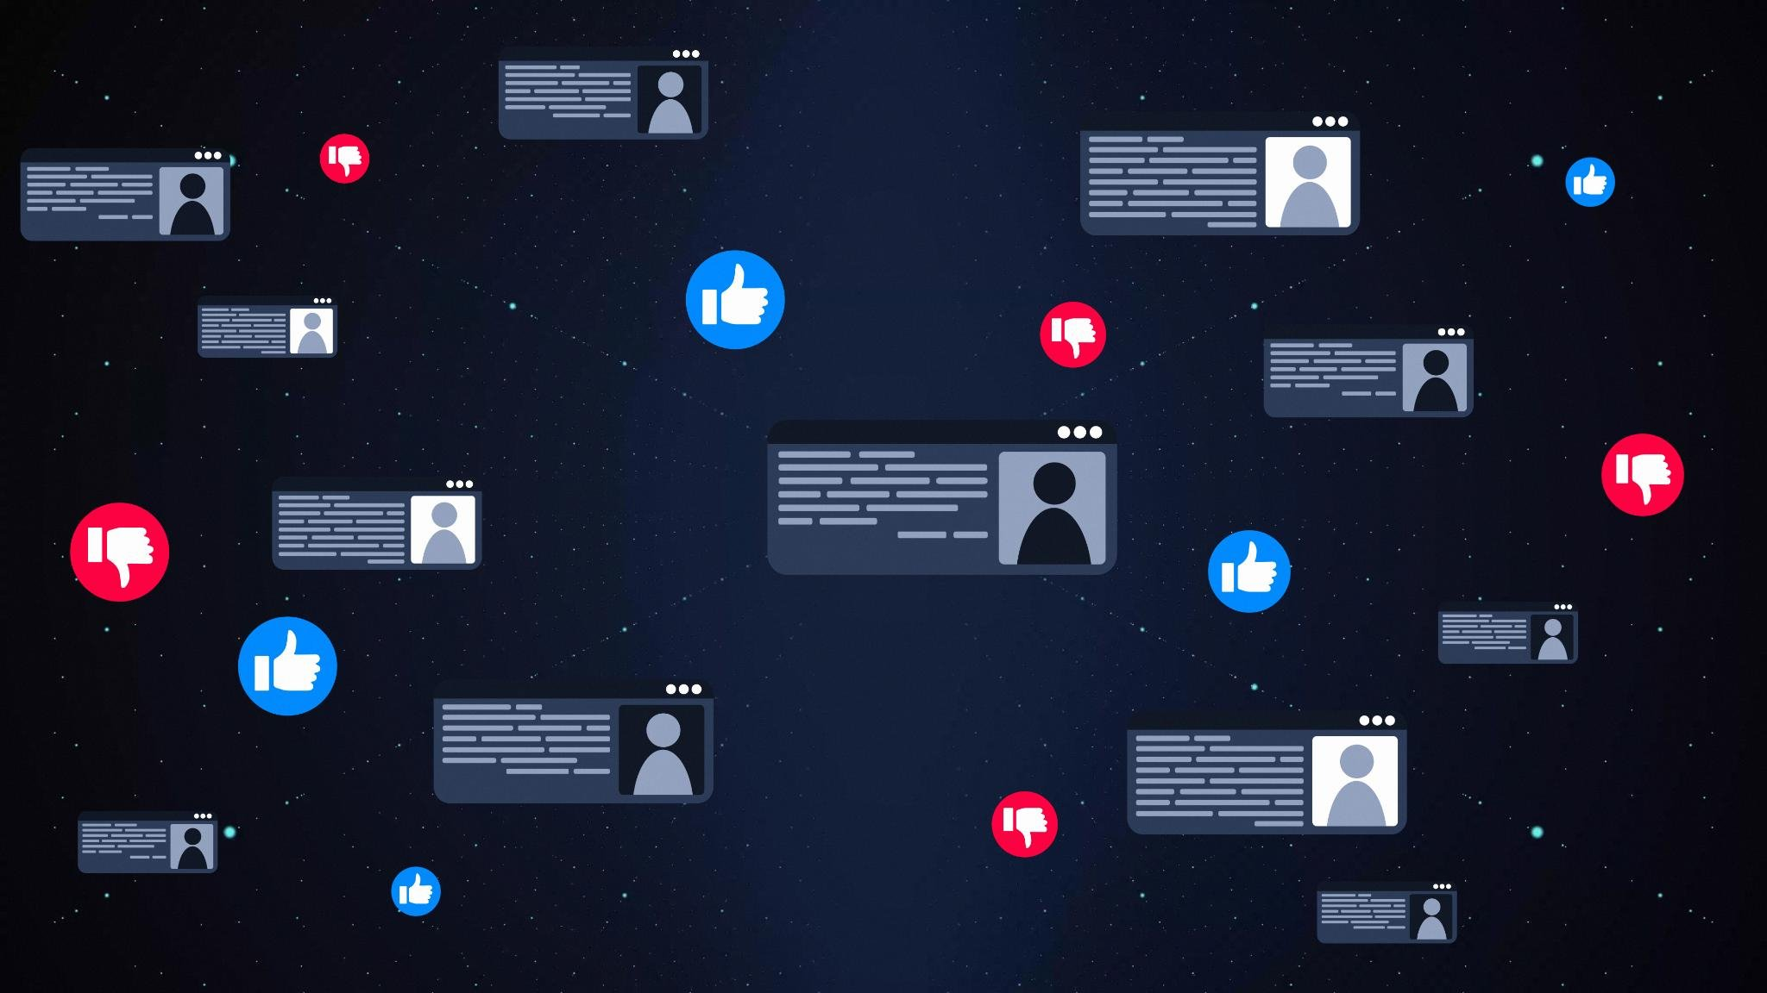
Why establish an Enablement Hub?
Centralized Knowledge Base​
The hub acts as a single source of truth, centralizing enablement resources for easy access and consistency.​
Streamlined Onboarding​
New users quickly gain essential knowledge, reducing ramp-up time and improving proficiency.​
Reduced SME Dependency​
Centralization reduces reliance on subject matter experts, allowing them to focus on higher-value work.​
Scalable and Adaptive​
The hub supports future growth and integration of new Adobe products with flexibility and agility.​

Slide 11
Enablement Hub personas
Users
Leaders
Non-Users
General Interest
What they do..
Uses Adobe applications in their day-to-day work, ranging from sporadic users to Super Users.
lead teams that use Adobe applications, or work with teams that do.
do not directly use Adobe applications but work with teams that do.
…are curious about Adobe, but do not use or work with teams that use Adobe applications.
What everyone can do…
Learn about Adobe solutions and capabilities
Stay up-to-date on the program
Requesting access to Adobe solutions
Finding and completing training for Adobe solutions
Submitting feedback or training requests
Keeping a pulse on Adobe program progress
Submitting feedback or training requests for their team
Keeping a pulse on Adobe program progress
Learning about Adobe and how SRHSS is using its solutions
Unique needs…

Slide 12
Enablement Hub example
Homepage
Welcome to the enablement hub & what it is
Overview of the program/vision & results to-date
Key contacts & program team members
Adobe Solution Training
FAQ
Have feedback or need to request enablement?
For all sub-pages, start the page with a short overview blurb that states what the page is about and when to leverage it.
Key Contacts
Adobe Solution Training
Frequently Asked Questions
For all blocks, have a sub-header on when to contact them and for each person include the person’s name, SBUX email, title, ideally a picture
High-level learning journey: foundational, intermediate, advanced, certified
Aggregate frequently asked questions & add responses/links to other places on the site where answers are stored
High-level overview of training resources available
Leadership sponsors
Topics to include:
Who to contact to get access to Adobe solutions at Starbucks
How to get support with an Adobe product issue
Link to the Adobe product roadmap (what features will be released/when)
How to get access to ADLS/ExL
How to provide feedback
How to request trailed training or enablement
Program team
Role-based/persona-based learnings)
Adobe Solution Administrators
Adobe Solution Super Users
self-help guides, tutorials and videos
Page
Content

Slide 13
How does this apply to SHRSS?
What aspects of this make sense for SHRSS?
What can be tailored to your specific needs?
What would an ideal state look like?
Where would you like to dive deeper?
What are potential enablement hub locations and owners?

